Slide 1
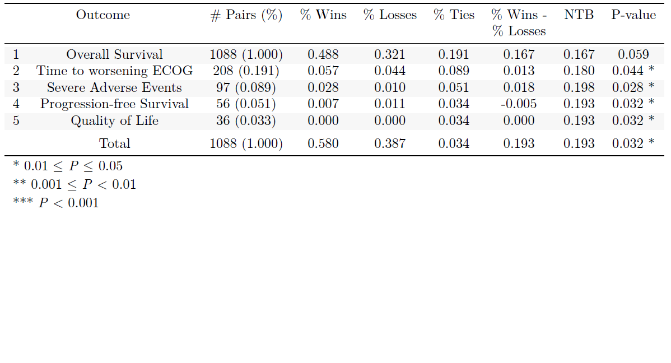
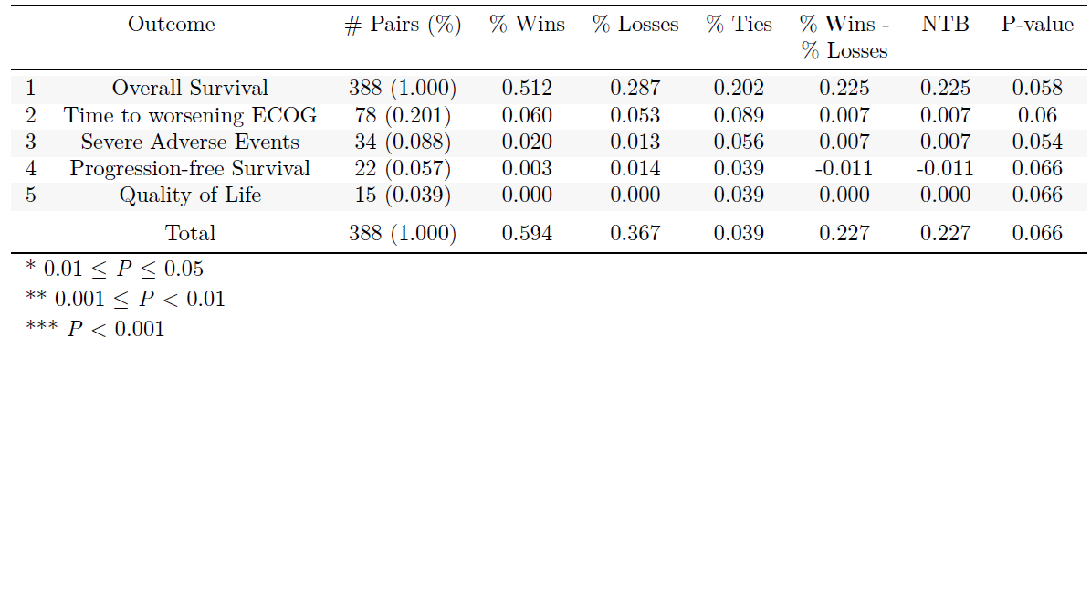
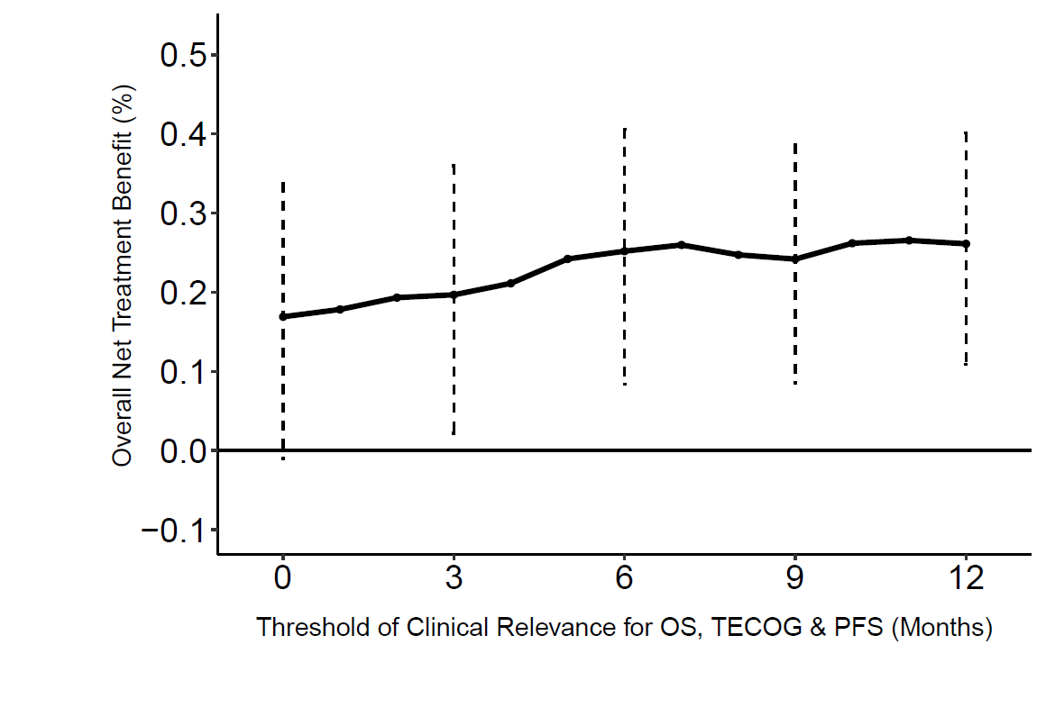
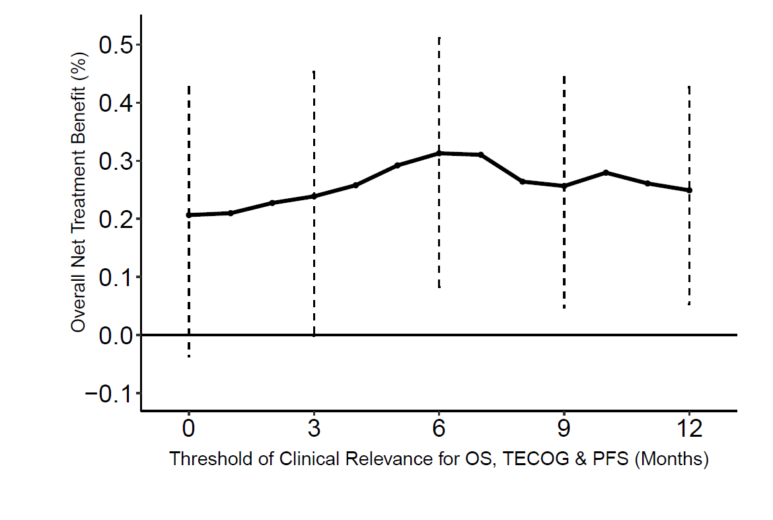
1024P
Net Treatment Benefit of OSE2101 in HLA-A2+ non-small cell lung cancer (NSCLC) patients after failure to immune checkpoint inhibitors (IO) in Phase 3 Atalante-1 randomized trial
Authors: ¹M. Buyse, ²F. Montestruc, ¹JC. Chiem, ¹V. Deltuvaite-Thomas, ¹S. Salvaggio, ³M. R. Garcia Campelo, ⁴M. Cobo Dols, ⁵E.A. Quoix, ⁶A.-C. Madroszyk Flandin,
⁷F. Cappuzzo, ⁸G. Romano, ⁹S. Viteri Ramirez, ¹⁰W. Schuette, ¹¹A. Zer, ¹²S. Comis, ¹²B. Vasseur, ¹³R. Dziadziuszko, ¹⁴G. Giaccone, ¹⁵B. Besse, ¹⁶E. Felip
¹International Drug Development Institute (IDDI), Louvain-la-Neuve, Belgium; ²eXYSTAT, Malakoff, France; ³Complejo Hospitalario Universitario A Coruña, A Coruña, Spain; ⁴Hospital Regional Universitario Málaga Carlos Haya, Malaga, Spain; ⁵Hopitaux Universitaires de Strasbourg - Nouvel Hopital Civil, Strasbourg, France; ⁶ Institut Paoli-Calmettes, Marseille, France; ⁷IRCCS Regina Elena National Cancer Institute, Rome, Italy; ⁸Ospedale Vito Fazzi - ASL Lecce, Lecce, Italy; ⁹Instituto Oncológico Dr. Rosell,
Hospital Universitario Dexeus, Grupo Quironsalud, Barcelona, Spain; ¹⁰Martha-Maria City Hospital Halle-Doelau, Halle, Germany; ¹¹Davidoff Cancer Center, Rabin Medical Center, Petah Tikva, Israel; ¹²OSE Immunotherapeutics, Paris, France;
¹³Medical University of Gdansk, Gdansk, Poland; ¹⁴Weill Cornell Medicine, New York, MD, United States of America; ¹⁵Gustave Roussy, Villejuif, France; ¹⁶Vall d'Hebron University Hospital and Vall d’Hebron Institute of Oncology, Barcelona, Spain
Background:
OSE2101 (Tedopi) is an anticancer vaccine that increased overall survival (OS) (HR 0.59, p = 0.017) versus Standard of Care Chemotherapy in the population of interest (PoI N = 118) of patients with IO secondary resistance after sequential CT-IO (Besse, ESMO 2021). In the overall population with primary and secondary resistance to IO (N=219), OS improvement of OSE2101 (HR = 0.86, p = 0.35) was lower.
The Net Treatment Benefit (NTB) combines efficacy and safety endpoints to test the overall improvement in health outcome between 2 randomized treatments (Buyse, 2010). NTB is the net probability that a patient in the OSE2101 arm has a better outcome than a patient in the Standard of Care Chemotherapy arm.
Table 1: Net Treatment Benefit (NTB) in overall population (N=219)
Table 2: Net Treatment Benefit (NTB) in population of interest (PoI) (N=118)
Figure 1: Net Treatment Benefit (NTB) as a function of the threshold of clinical relevance for times to event
Methods:
NTB was tested by comparing the following prioritized outcomes using Generalized Pairwise Comparisons (GPC):
1. OS (threshold = 2 months)
2. Time to worsening ECOG (TECOG) (threshold = 2 months)
3. Severe adverse event (Yes/No)
4. Progression free survival (shorter vs. longer than 2 months)
5. Quality of Life (threshold =5 points difference on Global Health Status: Items 29-30 of EORTC-QLQC30).
The analysis was stratified using the 3 initial strata of the study (histology, best response to 1rst line, and line of prior IO) and enrollment time (before vs during COVID-19). NTB was assessed in the both populations: ITT and PoI. Sensitivity analyses used no stratification and different thresholds of clinical relevance.
Conclusion:
An overall improvement in health outcome was observed with OSE2101 in the overall population of advanced NSCLC after IO failure with a NTB of 19% over SoC (p = 0.032).
In PoI with IO secondary resistance after CT-IO, the NTB was 23% (p = 0.066).
Sensitivity analyses with different orders for the prioritized outcomes showed similar patterns but the results did not always reach statistical significance due to the limited sample size and the impact of stratification factors.
These results provide an overall assessment of the benefit / risk of OSE2101 combining efficacy and safety endpoints. NTB favored OSE2101 over Chemotherapy in the overall population of IO resistance and in the PoI of secondary resistance to IO.
These data need confirmation in a second prospective trial.
Overall
Population: the NTB was equal to 19% for a threshold of 2 months, and larger values for thresholds up to 12 months
19%
2
Population of Interest (PoI): the NTB was equal to 23% for a threshold of 2 months and larger values for thresholds up to 12 months
Results:
In the primary analysis (1088 pairs) in the overall population, NTB was 19% and reached statistical significance in favor of OSE2101 (p = 0.032). In unstratified analysis (11120 pairs), NTB was 11% (p = 0.178).
In the PoI (388 pairs), NTB was 23% (p stratified = 0.066) and 28% (p = 0.014) in unstratified analysis (3040 pairs).
23%
Author Contact: marc.buyse@iddi.com
We thank all investigators and their study teams, all patients and their families.
References: Besse B, et al. #47LBA ESMO 2021. Annals of Oncology (2021) 32 (suppl 5): S1283-S1346; Buyse M, Statistics in Medicine (2010) 29: 3245-57. Copies of this poster are for personal use only and may not be reproduced without permission from ESMO and the author of this poster.
2

